Slide 1
Twitter Search
Nov. 17 2021

Slide 2


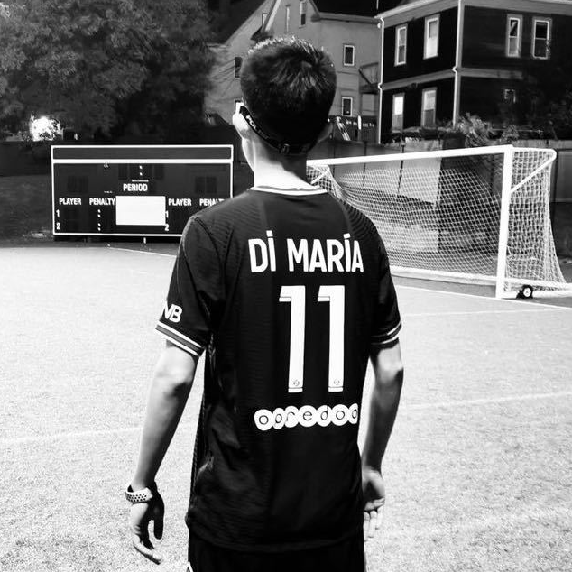

Contributor
Zhang, Yiwei
Zhang, Chenbo
Yang, Shizhe
Sun, Haoxiang
The shy boy who don't want to self-introduce.
The happy one.
Impatient,
selfish,
arrogant
I'm not really interested in this major.
But at least he’s cool. --- Chenbo

Slide 3
Word Matching
Ranking
CORE
Knuth Morris String Matching, etc.
Quick Sort, Bucket Sort, etc.
Notes:
Match Count Sort

Slide 4
Brief Outline
Twitter API
CORE
UI
Fetch the data
The Twitter API can help us fetching twitter results base on keywords, so we can try to fetch real data instead of generating test data.
Count and sort
The Twitter search can be break down to counting the amount of keywords and sorting them, then the result can be list in a oder of relevant.
Oder of time can be easier sort by time stamp.
Return the result
We hope to develop a friendly user interface so that somehow it can be better than the original one. We want it to be clear, simple, easy to use and friendly to everyone.
Notes:
ui part: suggest vanilla twitter not friendly to senior people.

Slide 5
Milestone
Nov.25
Finish Building Word Matching and Ranking Algorithm.
Dec. 07
Wrap them up and finish.
Nov. 19
Core Algorithm Research and Develop
Dec. 01
Research about twitter api to extract items from keyword.
Try to use our algorithm instead of theirs.
Dec. 12
All material hand in.

Slide 6
Project on github
https://github.com/MarianaEel/Twitter_Search_Algorithm.git
We welcome every visitor and every suggestion

